Slide 1
Cervical Cancer: Basic Pathology
OLAGBENRO Michael
Chairman/Chief Executive,
The Michael Agbaakin Foundation
www.michael-agbaakin.com

Slide 2
Objectives.
To understand what cancers are.
To understand what cervical cancer is.
What does YOUR cervix mean to YOU?
To understand how cervical cancer develops.
To understand how cervical cancer kills.
Real life example.
To understand implications for prevention/cure.
To influence our decision making and lifestyle choice.

Slide 3
Outline:
Introduction
Invitation
What do YOU know?
Basic Pathology of Cervical Cancer.
What do YOU know now?
What do you choose to do?
Questions, comments and contributions
Write on a sheet of paper, pass to me.

Slide 4

Introductions: - myself [introduce yourself when you ask your questions] - who/what I represent.

Slide 5

I invite you to join me
Doctor On Air:
On WhatsApp – send an sms on whatsapp to 0703 424 3196
On Facebook – www.facebook.com/DoctorOnAir
I teach on Saturdays and Sundays.
Service is FREE.
We hope to have a live TV show.

Slide 6
What do you know?
What is a cancer?
What is the Cervix?
So, what is cancer of the cervix?
Can cancer of the cervix be prevented?
Can cancer of the cervix be cured?
Does cancer of the cervix kill?
WHAT IS MY RESPONSIBILITY AS A WOMAN?
WHAT IS MY RESPONSIBILITY AS A MAN?
WHAT IS OUR RESPONSIBILITY AS A SOCIETY?

Slide 7
A few pictures . . .

Slide 8
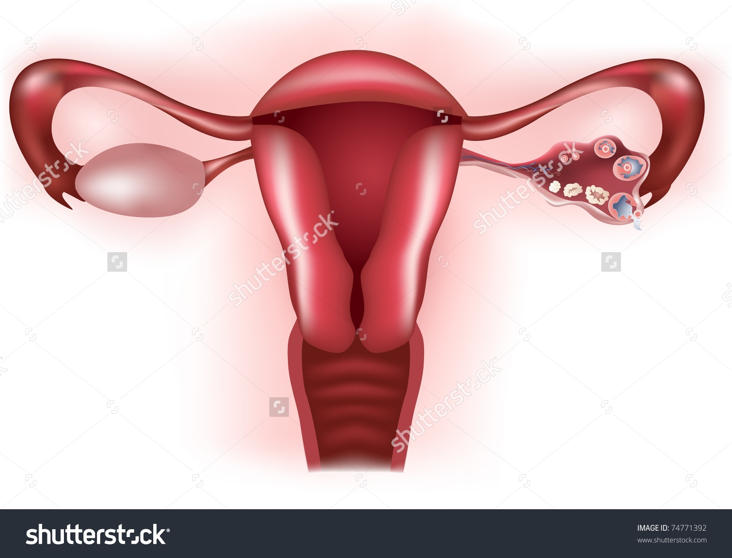
Diagram showing female reproductive tract.

Slide 9
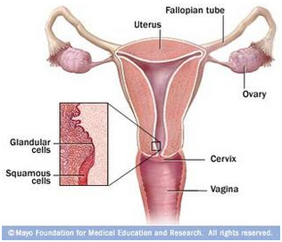
Diagram highlighting the squamo-collumnar junction.

Slide 10
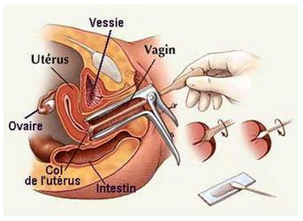
Diagram illustrating cervical smear. https://georgenpapanicolaou.wikispaces.com/The+Pap+Test

Slide 11
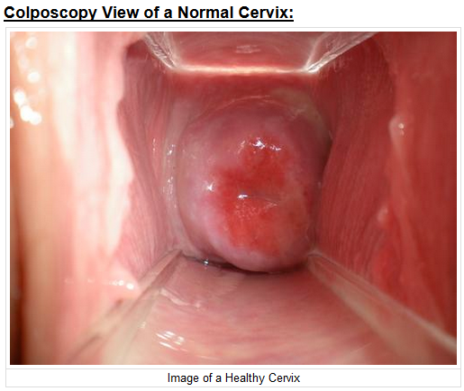
https://georgenpapanicolaou.wikispaces.com/The+Pap+Test

Slide 12
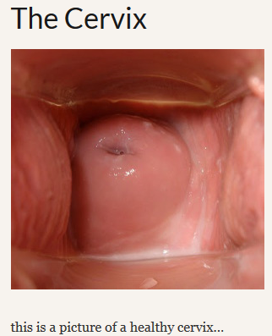
https://jemimamaccouu1986.wordpress.com/the-cervix-2

Slide 13
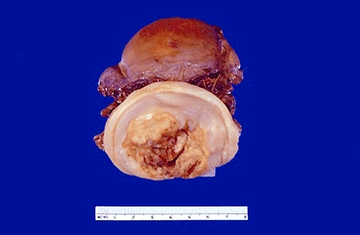
Picture of cancer limited to the cervix. http://library.med.utah.edu/WebPath/FEMHTML/FEM012.html

Slide 14
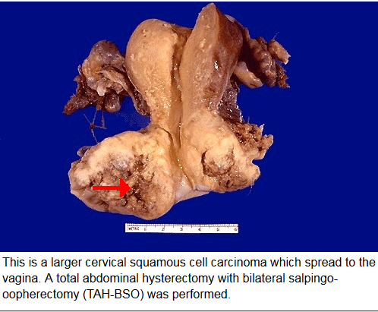
http://library.med.utah.edu/WebPath/FEMHTML/FEM014.html

Slide 15
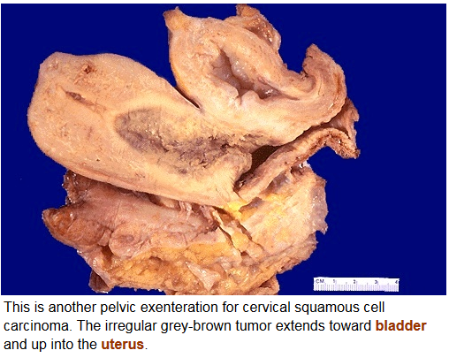
http://library.med.utah.edu/WebPath/FEMHTML/FEM016.html

Slide 16
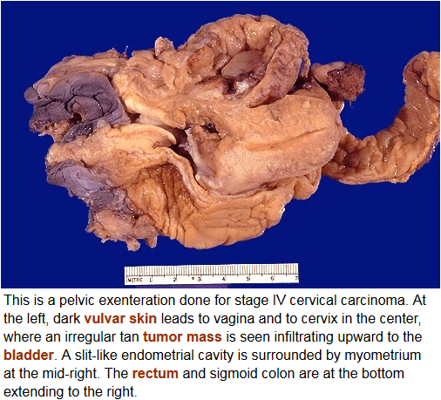
http://library.med.utah.edu/WebPath/FEMHTML/FEM015.html

Slide 17
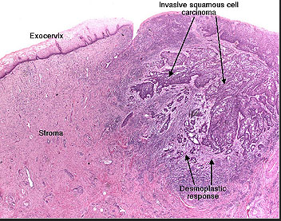
Photomicrograph of cervical cancer [squamous cell carcinoma] http://missinglink.ucsf.edu/lm/IDS_107_Cervix_Ovary_Uterus/ASSETS/Slide329SCClp_small.JPG

Slide 18
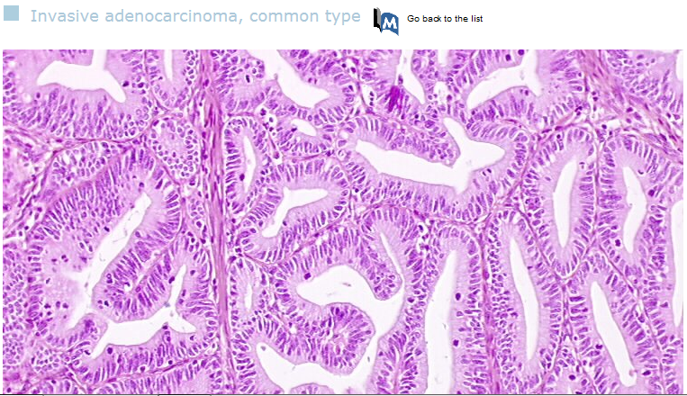
Photomicrograph of cervical cancer [adenocarcinoma] http://screening.iarc.fr/atlashisto_detail.php?flag=1&lang=1&Id=00002289&cat=F2c1

Slide 19
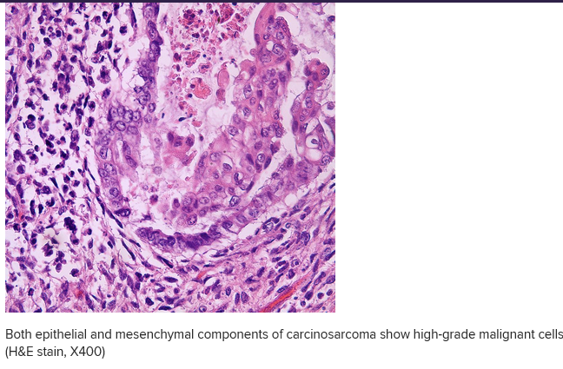
Photomicrograph of cervical cancer [carcinosarcoma] http://emedicine.medscape.com/article/1611287-overview#a7

Slide 20
What do you know NOW?
What is a cancer?
What is the Cervix?
So, what is cancer of the cervix?
Can cancer of the cervix be prevented?
Can cancer of the cervix be cured?
Does cancer of the cervix kill?
WHAT IS MY RESPONSIBILITY AS A WOMAN?
WHAT IS MY RESPONSIBILITY AS A MAN?
WHAT IS OUR RESPONSIBILITY AS A SOCIETY?

Slide 21
What do you CHOOSE TO DO?
Is your cervix important to you?
Will you protect your cervix?
Will you delay/avoid coitus?
Will you get screened for cervical cancer?
Will you get vaccinated for cervical cancer?
Will you share with your friends [& enemies, haters and frenemies] what you know about cervical cancer?
If your answer to ALL is YES, give yourself a standing ovation!

Slide 22

Thank you for listening. Join me on Doctor On Air Write and send me your questions.

